Slide 1
The Harmonic Oscillator
1) The basics
2) Introducing the quantum harmonic oscillator
3) The virial algebra and the uncertainty relation
4) Operator basis of the HO

Slide 2




The Classical Harmonic Oscillator
Archetype 1: Mass m on a spring K
Hamiltonian
Archetype 2: A potential motion problem; motion near the
fixed point.
with
At fixed point, dV/dx = 0 so that H is approximately that of HO

Slide 3




The Classical Harmonic Oscillator
Equations of Motion:
The general solution depends on 2 parameters:
A amplitude
phase
Note: thinking about this as a spring and mass, recall

Slide 4

The Classical Harmonic Oscillator
More on the classical harmonic oscillator:
0) Lowest possible energy is 0
(resting at the bottom of the quadratic well
1) Classical Turning Point
All solutions have a strictly limited spatial
extent...the largest x is called
The classical turning point
E = V(
)

Slide 5



The Quantum Harmonic Oscillator
We want to discover and solve the/a quantum mechanical
system that has as a classical limit the previous situation.
Need to find
Obvious Candidate: Relate the linear operators to the
classical observables
So we guess:

Slide 6




The Quantum Harmonic Oscillator
Now use the x-basis;
We investigate this candidate (!) by studying the
energy eigenstates:
To simplify the D.E. Somewhat, we go to dimensionless
quantities,
So that the energy eigenstate equation becomes;

Slide 7




We proceed solving this through two steps:
First take as an ansatz :
For some function P(y). Putting this into the D.E. above, leads
to the resulting equation in the function P(y);
One can search for power series solutions to this equation ...
check the book section below eq. 7.3.11. There are
finite series solutions (i.e. polynomial) in terms of the
so-called Hermite polynomials

Slide 8


“You are now being given a single page sheet of all about
Hermite polynomials...this may be of use for problems. “
<hand out and discuss>
Summary of the solution to the QHO
with normalization constant:
Note: Parity; the n=even wavefunctions are even,
the n=odd wavefunctions are odd.
And since the hamiltonian is even, the expectation value on
energy eigenstates of odd functions are identically zero.
Ex:

Slide 9
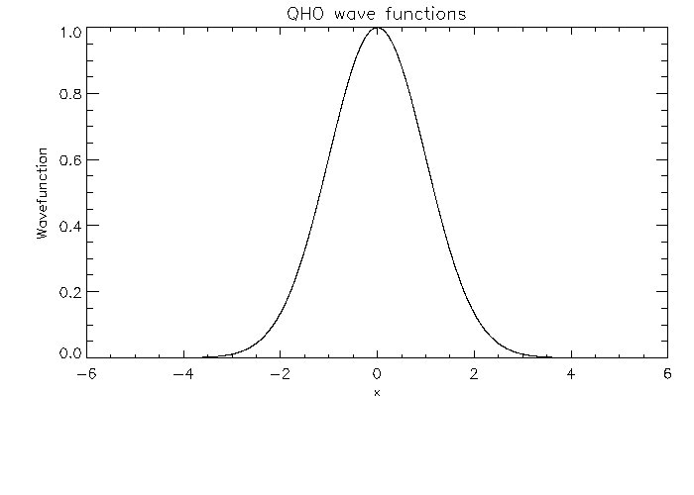
n=0 The Ground State

Slide 10
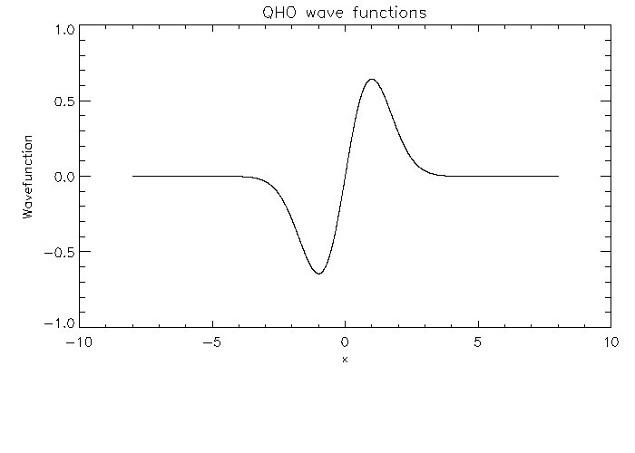
n=1 The first excited state

Slide 11
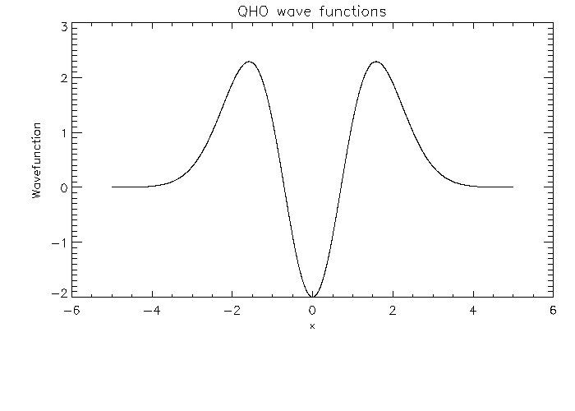
N=2

Slide 12
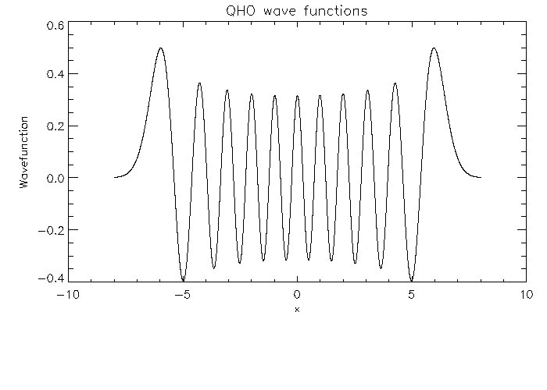
What is n?

Slide 13

The Virial Subalgebra and the Uncertainty Principle
We now take a happy algebraic interlude that is not quite
in the book, but spotlights (and I think streamlines and
generalizes) the discussion on pages 198-200
The Virial Subalgebra
For simplicity, take a 1-d hamiltonian;
(Note: this following argument generalizes to all dimensions!)
(we drop hats...)
but now specialize to the case where the potential is
a homogeneous function of degree r

Slide 14



The Virial Subalgebra and the Uncertainty Principle
The Virial Subalgebra
(con't)
Now, in the space of all observables, for example, operators
that are functions of the 'p' and 'x', we focus on a closed
subalgebra generated by the Hamiltonian and the operator
Here are some intermediate steps that allow us to identify
the operators in this virial subalgebra;
The definition of 'B'

Slide 15



The Virial Subalgebra and the Uncertainty Principle
(from prev. page)
Now commute around the B to discover what we need
to close this algebra. For example, direct calculation
indicates that
This RHS is a linear
combination of H and B !
&
The right hand side here is strongly reminiscent of

Slide 16





The Virial Subalgebra and the Uncertainty Principle
Now, the QHO is a special case of this construction
with
So, specializing to the
case, we find
! and the algebra closes !
This algebra is actually
, the continuous
symmetries of a cone!
For example, for
the cone
is
Class Discussion: time evolution as motion on this cone...

Slide 17




The Virial Subalgebra and the Uncertainty Principle
What good is all this? Well, we are now just one step away
from the quantum virial theorem and its use in understanding
the uncertainty relations for the energy eigenstates of the QHO.
Take :
and compute the expectation
value of this on energy eigenstates;
Well, note that
(Why?)
And so
0
But, this means
Which since
for the QHO, we have

Slide 18






The Virial Subalgebra and the Uncertainty Principle
Or,
But, since we are computing the expectation value on energy
eigenstates,
Thus,
and
Now we can compute the uncertianty;
Recall;
And so...

Slide 19






The Virial Subalgebra and the Uncertainty Principle
a
And so;
So that on the energy eigenstates we have;
Which for the ground state,
since
with n=0 becomes,
Thus, the ground state saturates the Heisenberg uncertainty
bound...class discussion....

Slide 20

The Classical Limit of the QHO
We will discuss in more detail the classical limit later in
in this course. It is not the
0 limit, although we
typically think about
as setting the scale at which
our classical description breaks down.
We will see later
that, actually, the classical limit of quantum mechanics
is the large n limit (large quantum number).
In that limit the QHO energy eigenfunctions probability
density has a classical envelope;
(Class Discussion) Classical limit and the Quantum virial

Slide 21
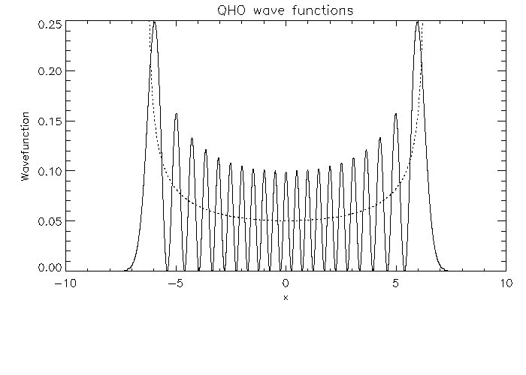
Comparison of Quantum Probability
(In n=20 state) and Classical Probability

Slide 22



The QHO done again...Operator formulation
Now that we have solved the QHO and studied aspects of
the solution and displayed evidence that it actually
corresponds with the classical HO, we now rederive the
QHO in from a more abstract, algebraic (and more useful!)
point of view.
This is not just repackaging; it will be key to undertstanding
more aspects of the classical limit and is also the basis of
the idea of what a particle is in quantum field theory.
Start with;
and define:

Slide 23




The QHO done again...Operator formulation
then becomes;
we can invert these as
Then can write the
hamiltonian as ;
Then,

Slide 24




The QHO done again...Operator formulation
As an operator on position basis...

Slide 25



The QHO done again...Operator formulation
Can Build up higher level states,
from |0> state...
Note:
Implements the commutator
On the
Hilbert space formed by all the
runs from
0 to infinty and is integer valued.

Slide 26

The QHO done again...Operator formulation
Can Build up higher level states,
from |0> state...
Note:
Implements the commutator
On the
Hilbert space formed by all the
runs from
0 to infinity and is integer valued.
is a “Lowering Operator”
is a “Raising Operator”

Slide 27
The QHO done again...Operator formulation
Can Build up higher level states,
from |0> state...
Note that
implements the commutator
On the
Hilbert space formed by all the
runs from
0 to infinity and is integer valued.
is a “Destruction Operator”
is a “Creation Operator”

Slide 28





The QHO done again...Operator formulation
Note also that;
Natural from
it is most relevant
to define
the “number operator.”
With
this means
That means it is counting the number of excitations above |0>
These operators allow us to build a tower energy eigenstates
from the vacuum;
let

Slide 29



The QHO done again...Operator formulation
Then we can use
to construct |1>. The algebra then implies
And we can continue in this way, constructing all the energy
eigenstates,
NOTE: This operator approach greatly simplifies the
computation of matrix elements. Ex:

Slide 30





Slide 31






